Slide 1
VSD 2020 Project Presentation Correlation Filter – based Object Tracking System
Team : VLSILAB
Members : 陳韋呈 黃建智 邱建智 黑崇瑜 高士鈞

Slide 2
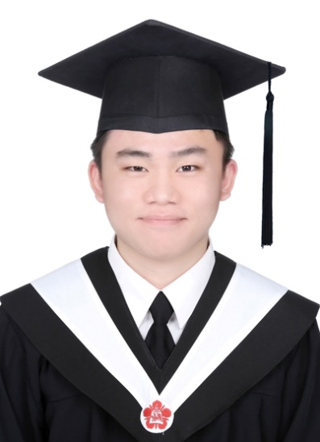
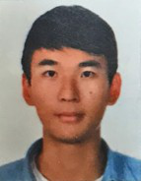
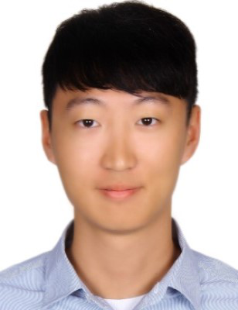
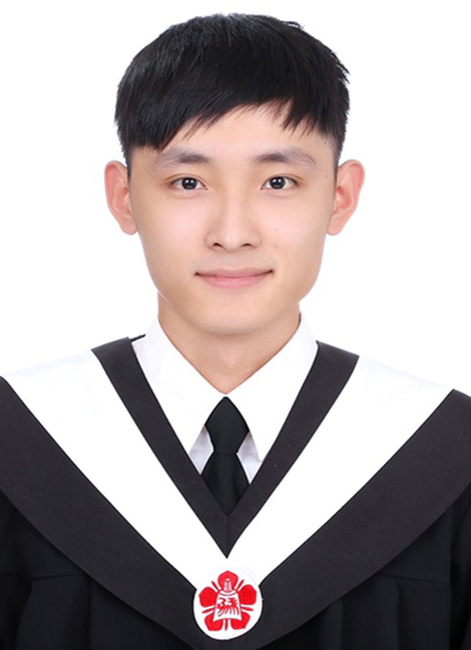
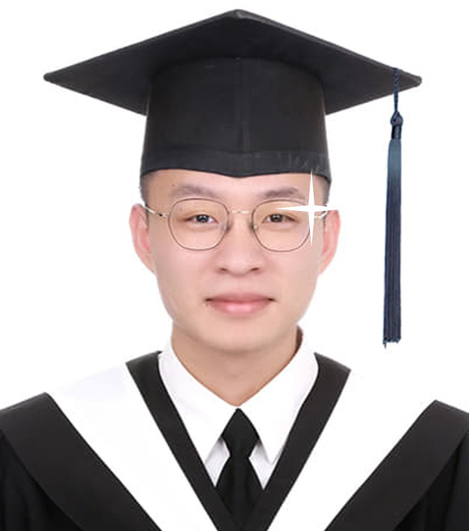
Member Introduction
陳韋呈
黃建智
邱建智
黑崇瑜
高士鈞

Slide 3
Outline
Introduction to the Application
Algorithm Analysis
System Architecture and Operating Flow
AP Architecture
System Specification
Benchmark
Conclusion and Future Work

Slide 4
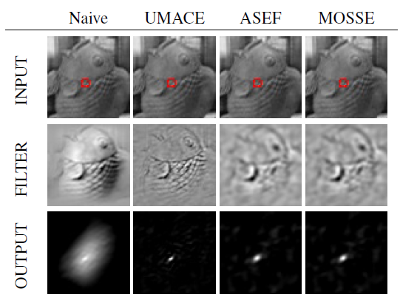
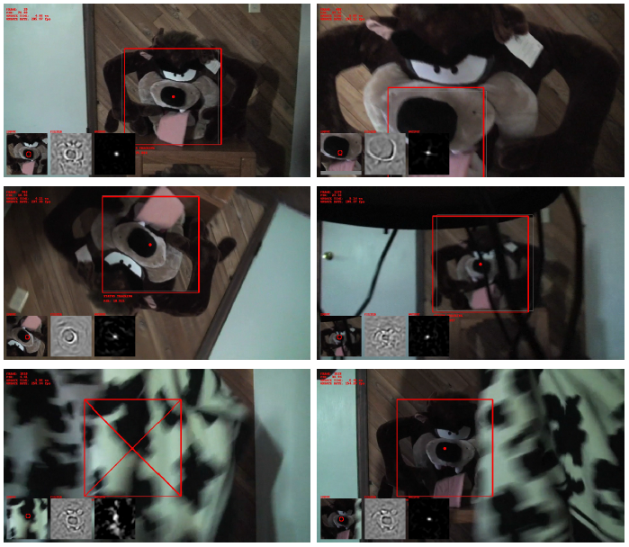
Introduction to the Application
Correlation Filter : An online-training correlation filter
Introduce the concept of signal correlation (Convolution) in DSP, DCF is a filter to calculate the correlation between filter and input frame.
To reduce the computing complexity, the correlation computing and the filter updating are both processed in frequency domain by doing Fast Fourier Transform.
D. S. Bolme, J. R. Beveridge, B. A. Draper and Y. M. Lui, "Visual object tracking using adaptive correlation filters", 2010 CVPR.

Slide 5
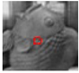
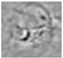
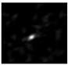
Correlation Filter – Tracking Process
Input
Filter
Response
Updating the Filter
Tracking the Object
Updating:
Update the filter according to the given input feature of the tracking target.
Tracking :
After filter updating, the location corresponding to the maximum value in the correlation output indicates the new position of the target.
The filter updating is then performed based on that new location.

Slide 6
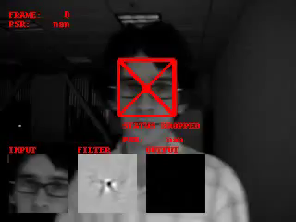

Slide 7
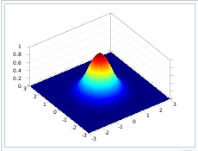
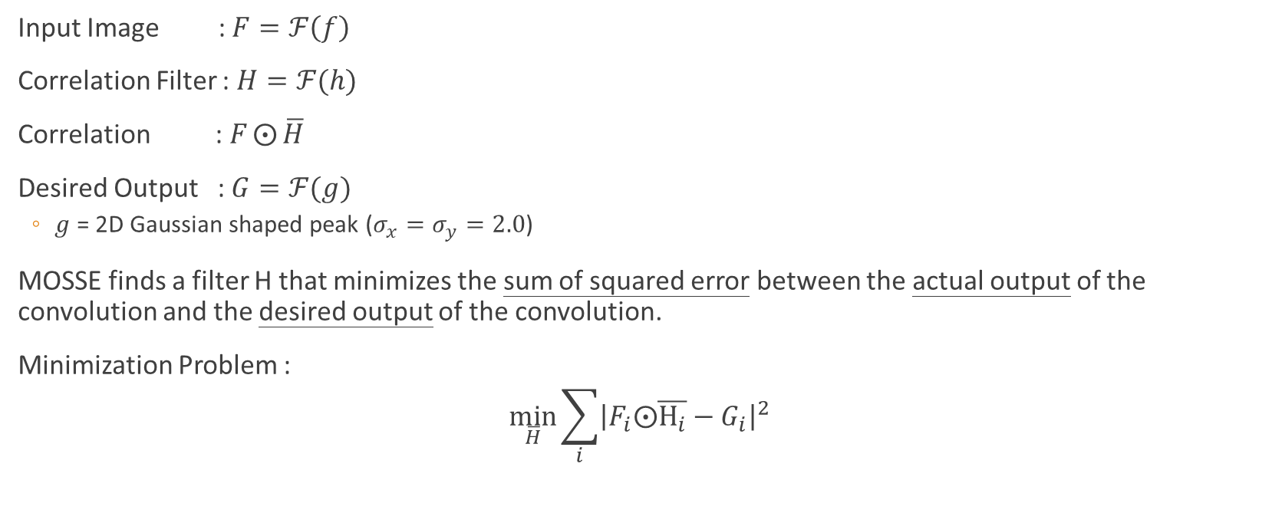
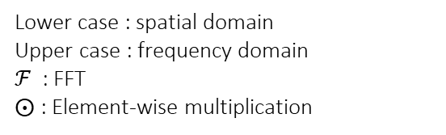
Algorithm
Input Image : $F=ℱ\left(f\right)$
Correlation Filter : $H=ℱ(h)$
Correlation : $F⨀{\overline{H}}$
Desired Output : $G=ℱ(g)$
$g$ = 2D Gaussian shaped peak ($σ_{x}=σ_{y}=2.0$)
MOSSE finds a filter H that minimizes the sum of squared error between the actual output of the convolution and the desired output of the convolution.
Minimization Problem :
$$\min_{\overline{H}}{\sum_{i}{{\left|F_{i}⨀\overline{H_{i}}−G_{i}\right|}^{2}}}$$
Lower case : spatial domain
Upper case : frequency domain
$ℱ$ : FFT
$⨀$ : Element-wise multiplication
, i : i-th frame
Notes:
Desired Output (也就是Ground Truth)是一個很強的response並且集中座落在search window的中心
作者使用2D的高斯分布當作訓練的ground truth
MOSSE的cost function是定義實際output和gt差值平方的累積總和
也就是說前幾個frame的資訊會一直被累積，且影響當前filter的更新

Slide 8
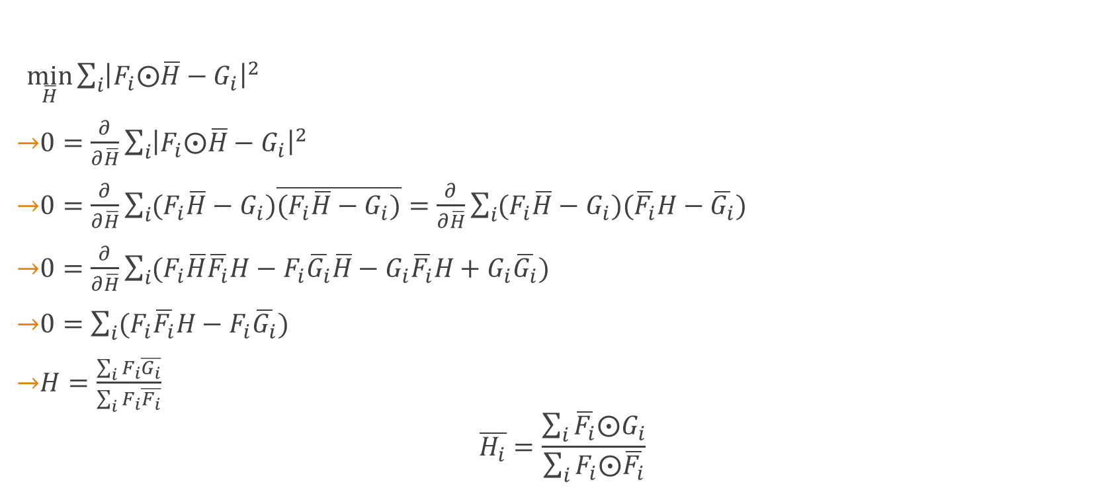
Derivation
$\min_{\overline{H}}{\sum_{i}{{\left|F_{i}⨀\overline{H}−G_{i}\right|}^{2}}}$
$0=\frac{∂}{∂\overline{H}}\sum_{i}{{\left|F_{i}⨀\overline{H}−G_{i}\right|}^{2}}$
$0=\frac{∂}{∂\overline{H}}\sum_{i}{(F_{i}\overline{H}−G_{i})\overline{(F_{i}\overline{H}−G_{i})}}=\frac{∂}{∂\overline{H}}\sum_{i}{(F_{i}\overline{H}−G_{i})(\overline{F_{i}}H−\overline{G_{i}}) }$
$0=\frac{∂}{∂\overline{H}}\sum_{i}{(F_{i}\overline{H}\overline{F_{i}}H−F_{i}\overline{G_{i}}\overline{H}−G_{i}\overline{F_{i}}H+G_{i}\overline{G_{i}})}$
$0=\sum_{i}{(F_{i}\overline{F_{i}}H−F_{i}\overline{G_{i}})}$
$H=\frac{\sum_{i}{F_{i}\overline{G_{i}}}}{\sum_{i}{F_{i}\overline{F_{i}}}}$
$$\overline{H_{i}}=\frac{\sum_{i}{\overline{F_{i}}⨀G_{i}}}{\sum_{i}{F_{i}⨀\overline{F_{i}}}}$$
Notes:
要解這個最佳化問題，很直觀的就是對cost function做對H bar的偏微分

Slide 9
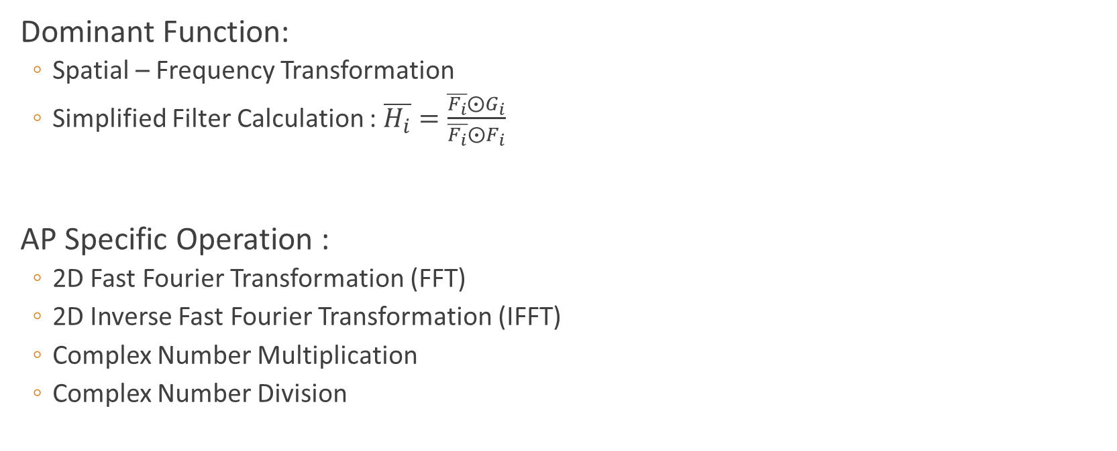
Algorithm Analysis
Dominant Function:
Spatial – Frequency Transformation
Simplified Filter Calculation : $\overline{H_{i}}=\frac{\overline{F_{i}}⨀G_{i}}{\overline{F_{i}}⨀F_{i}}$
AP Specific Operation :
2D Fast Fourier Transformation (FFT)
2D Inverse Fast Fourier Transformation (IFFT)
Complex Number Multiplication
Complex Number Division

Slide 10
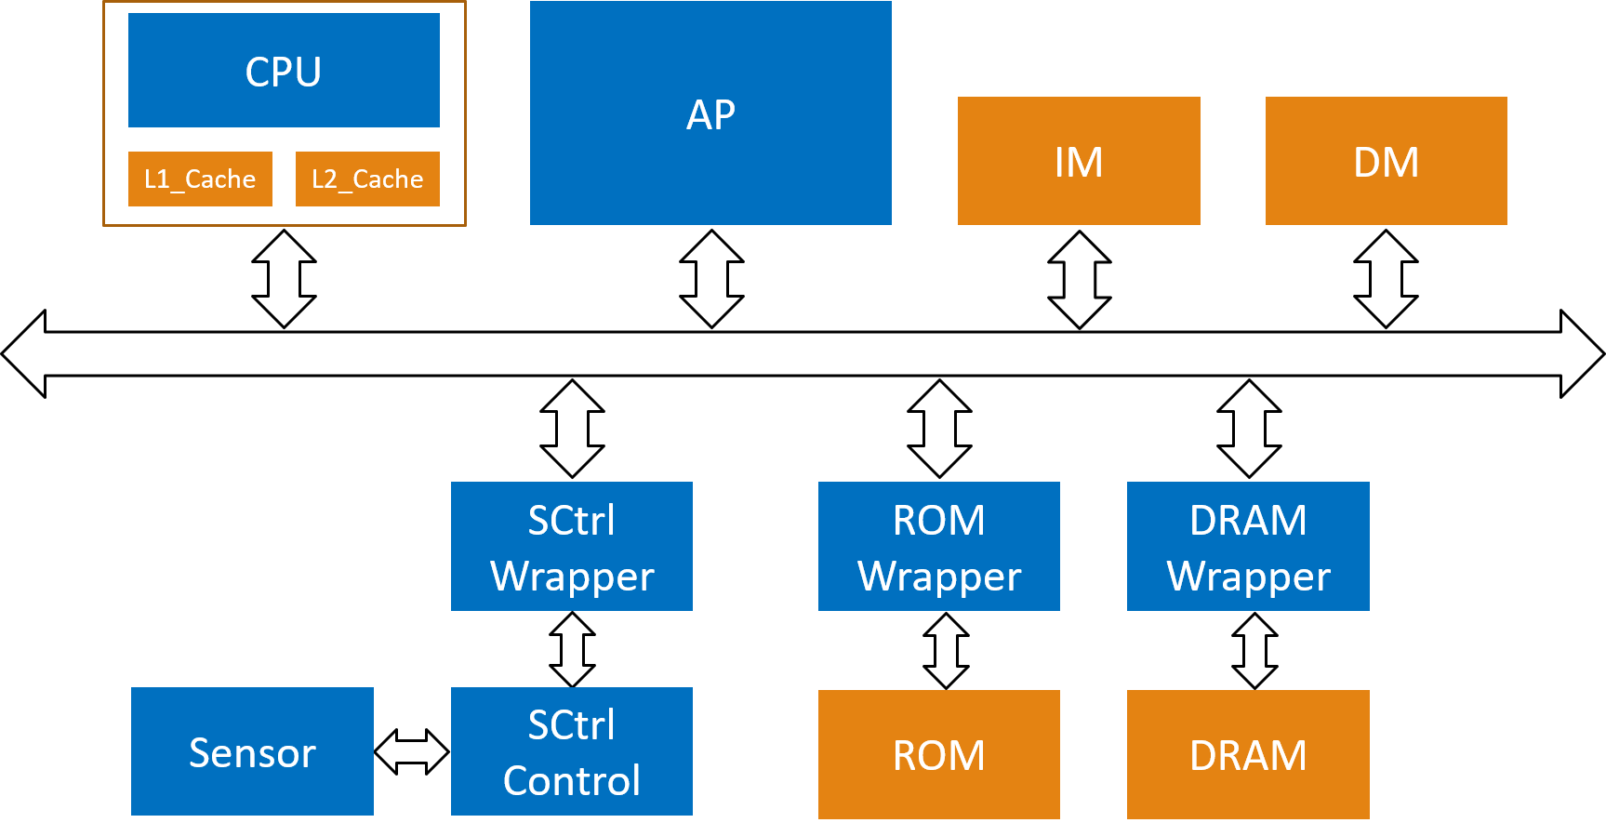
System Architecture
L1C_Cache
L1D_Cache
AXI

Slide 11
Operating Flow
1. CPU move data from DRAM to AP (Frame0)
L1C_Cache
L1D_Cache

Slide 12
Operating Flow
1. CPU move data from DRAM to AP (Frame0)
2. CPU send Control Signal to AP
(FFT + Divide)
L1C_Cache
L1D_Cache

Slide 13
Operating Flow
1. CPU move data from DRAM to AP (Frame0)
2. CPU send Control Signal to AP
(FFT + Divide)
3. When AP operating, CPU move data from DRAM to AP (Frame1)
L1C_Cache
L1D_Cache

Slide 14
Operating Flow
1. CPU move data from DRAM to AP (Frame0)
2. CPU send Control Signal to AP
(FFT + Divide)
3. When AP operating, CPU move data from DRAM to AP (Frame1)
4. CPU send Control Signal to AP
(FFT + Multiply + IFFT)
L1C_Cache
L1D_Cache

Slide 15
Operating Flow
1. CPU move data from DRAM to AP (Frame0)
2. CPU send Control Signal to AP
(FFT + Divide)
3. When AP operating, CPU move data from DRAM to AP (Frame1)
4. CPU send Control Signal to AP
(FFT + Multiply + IFFT)
5. CPU wait for AP by accessing the specific location of AP.
L1C_Cache
L1D_Cache

Slide 16
Operating Flow
1. CPU move data from DRAM to AP (Frame0)
2. CPU send Control Signal to AP
(FFT + Divide)
3. When AP operating, CPU move data from DRAM to AP (Frame1)
4. CPU send Control Signal to AP
(FFT + Multiply + IFFT)
5. CPU wait for AP by accessing the specific location of AP.
6. CPU load the response map from AP and find the location of max value.
7. Repeat 1~6
L1C_Cache
L1D_Cache

Slide 17
AP Architecture
Slave
Register
Frame
(4KB)
1024-Point
2D FFT
32-bit
Complex
Number
Divider
Filter
Params
Memory
(8KB)
Input Frame
AXI
Control Signal
Controller
Slave
Register
Response
(4KB)
1024-Point
2D IFFT
32-bit
Complex
Number
Multiplier
Output Response

Slide 18

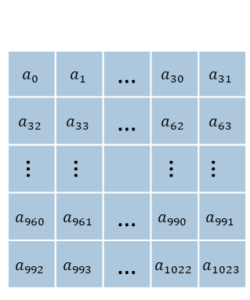

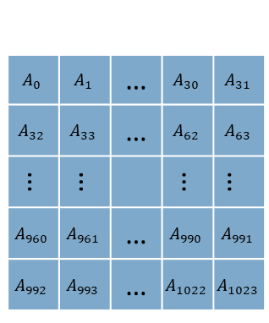

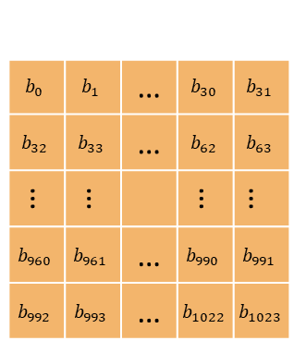
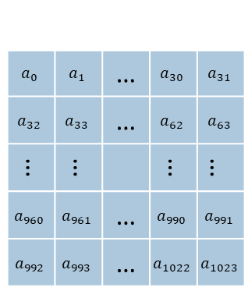

2D FFT
Flow :
1. Do 32-point FFT to each row
2. Do 32-point FFT to each column
$$a_{0}$$ | $$a_{1}$$ | … | $$a_{30}$$ | $$a_{31}$$
$$a_{32}$$ | $$a_{33}$$ | … | $$a_{62}$$ | $$a_{63}$$
… | … |  | … | …
$$a_{960}$$ | $$a_{961}$$ | … | $$a_{990}$$ | $$a_{991}$$
$$a_{992}$$ | $$a_{993}$$ | … | $$a_{1022}$$ | $$a_{1023}$$
$$a_{0}$$ | $$a_{1}$$ | … | $$a_{30}$$ | $$a_{31}$$
$$a_{32}$$ | $$a_{33}$$ | … | $$a_{62}$$ | $$a_{63}$$
… | … |  | … | …
$$a_{960}$$ | $$a_{961}$$ | … | $$a_{990}$$ | $$a_{991}$$
$$a_{992}$$ | $$a_{993}$$ | … | $$a_{1022}$$ | $$a_{1023}$$
$$second FFT$$
$$A_{0}$$ | $$A_{1}$$ | … | $$A_{30}$$ | $$A_{31}$$
$$A_{32}$$ | $$A_{33}$$ | … | $$A_{62}$$ | $$A_{63}$$
… | … |  | … | …
$$A_{960}$$ | $$A_{961}$$ | … | $$A_{990}$$ | $$A_{991}$$
$$A_{992}$$ | $$A_{993}$$ | … | $$A_{1022}$$ | $$A_{1023}$$
$$first FFT$$
$$b_{0}$$ | $$b_{1}$$ | … | $$b_{30}$$ | $$b_{31}$$
$$b_{32}$$ | $$b_{33}$$ | … | $$b_{62}$$ | $$b_{63}$$
… | … |  | … | …
$$b_{960}$$ | $$b_{961}$$ | … | $$b_{990}$$ | $$b_{991}$$
$$b_{992}$$ | $$b_{993}$$ | … | $$b_{1022}$$ | $$b_{1023}$$
$$Input Data$$
$$Output Data$$

Slide 19
1024-Point 2D FFT/IFFT
Folding Architecture
32-point
FFT/IFFT
Local MEM
Real_in
Local MEM
Imag_in
Re-index
Real_out
Imag_out

Slide 20
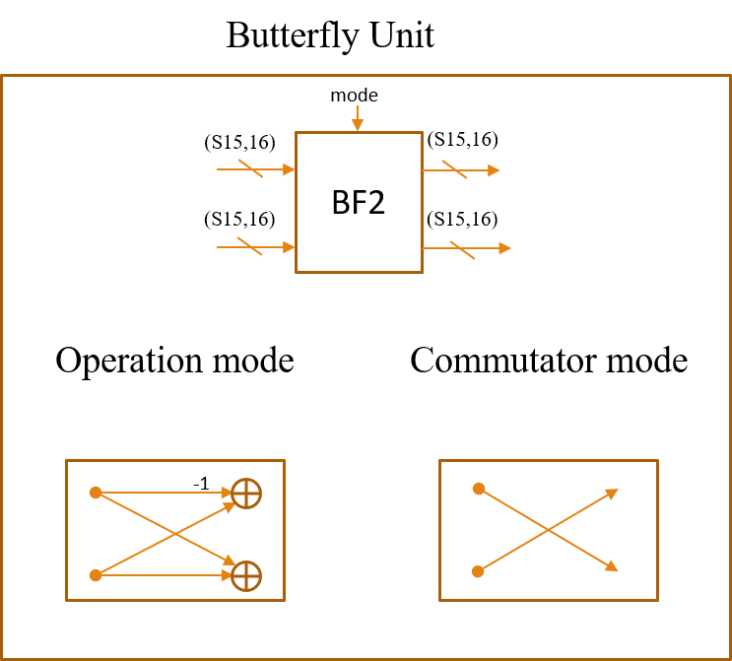
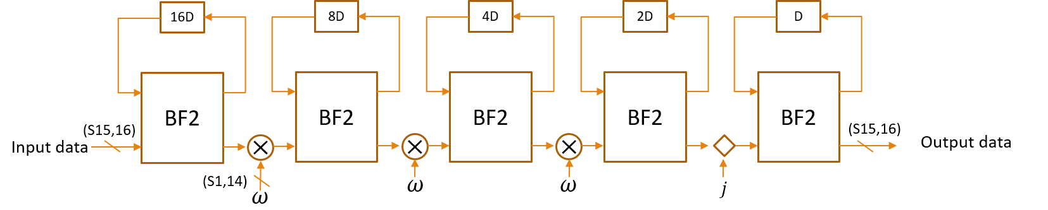
32-point FFT
R2SDF
Radix-2 Single-Path Delay Feedback
5 Butterfly Units, 3 Complex Multipliers
Data : 32-bit Fixed-Point Value
Twiddle Factor : 16-bit Fixed-Point Value

Slide 21
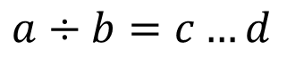
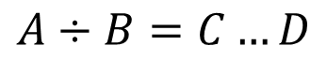
32-bit Divider
32-stage pipeline divider.
Use subtraction to realize divide operation.
$$A÷B=C…D$$
$$a÷b=c…d$$
Pipeline Stage 0
C[31]
Pipeline Stage 1
Pipeline Stage 31
A[31:0]
A>B?
A[30:0]
C[31:0]
a[31:0]
Divide
Unit
Divide
Unit
1
0
c
C[31]
D0[30:0],
A[30]
C[30]
……
30’d0,A[31]
b[31:0]
B[31:0]
A-B
d[31:0]
D0[31:0]
B[31:0]
D1[31:0]
D[31:0]
B[31:0]

Slide 22
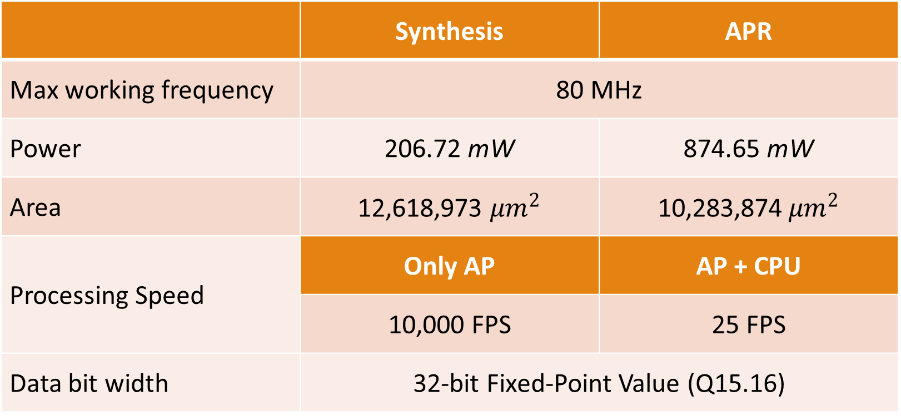
System Specification
 | Synthesis | APR
Max working frequency | 80 MHz
Power | 206.72 mW | 874.65 mW
Area | 12,618,973 ${μm}^{2}$ | 10,283,874${ μm}^{2}$
Processing Speed | Only AP | AP + CPU
 | 10,000 FPS | 25 FPS
Data bit width | 32-bit Fixed-Point Value (Q15.16)

Slide 23
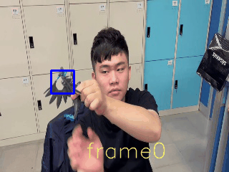
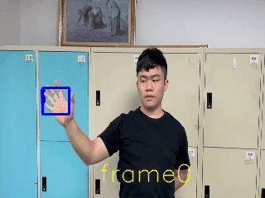
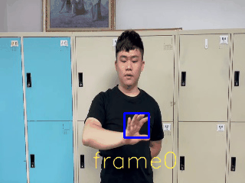
Benchmark
*Groundtruth of frame0 is given for the main program to initialize the filter.
We prepare ten sets of 3-frame video sequences.
To compute the bounding box’s IOU between our result and the groundtruth.
Average IOU : 85%
 | 1 | 2 | 3 | 4 | 5 | 6 | 7 | 8 | 9 | 10
frame1 | 100% | 90.8% | 35.2% | 100% | 100% | 96.9% | 100% | 100% | 93.8% | 29.7%
frame2 | 100% | 93.8% | 23.4% | 96.9% | 100% | 96.9% | 100% | 100% | 90.8% | 42.5%
Red : Groundtruth / Blue : Inference

Slide 24
Conclusion and Future Work
Conclusion
Our AP can operate 1024-point 2D FFT/IFFT ,32-bit complex number division and multiplication. And can be used to accelerate the correlation-based object tracking algorithm.
The system can work at 80 MHz, and speed up to 25 FPS.
Future Work
The system spends too much time on data movement.
Direct Memory Access
AXI Burst Mode
Because the lack of DMA, CPU always needs to move the data from DRAM to AP. If DMA is available, parallel processing can be realized.
Ex: When AP is doing FFT + divide (Filter Update), CPU can do FFT for response calculation.

